Slide 1
AutoHub(Vehicle Rental Application)
TEAM MEMBER :
GROUP NO:81
Harshal R. Nagtilak(230341220101)
Amit Thube(230341220226)
MENTOR :
Rupali Thorat Mam

Slide 2
PRESENTATION OUTLINE
Overview
Technology Used
Application Walkthrough
Conclusion

Slide 3
OVERVIEW
An AutoHub is a vehicle rental system that can be used to get vehicle on rent for a fee during a specified period. Getting a rental car helps people get around despite the fact they do not have access to their own personal vehicle or don't own a vehicle at all.
The individual who needs a car must contact a rental car company and contract out for a vehicle. This system increases customer retention and simplify vehicle and staff management.

Slide 4
TECHNOLOGY USED
Spring-Boot
React js
MySql

Slide 5
SPRING-BOOT
Spring Boot provides a good platform for java developers to develop a stand-alone and production-grade spring application that you can just run.
Easy to understand and develop spring applications.
Increases productivity
Reduces the development time.

Slide 6
REACT JS
React is a JavaScript library for building user interfaces.
React uses virtual DOM which is a javascript object.This improve apps performance,since javascript virtual DOM is faster than regular DOM.
React allow us to create reusable UI components.

Slide 7
MYSQL
MYSQL is a free open source system,we don’t need to spend money for this level of freedom,including upgrading to an advanced version.
MYSQL always prioritizes data security with its acess privilege system and user account management .
MYSQL offers smooth assistance with optimum speed,whether you store massive amount of big data.

Slide 8
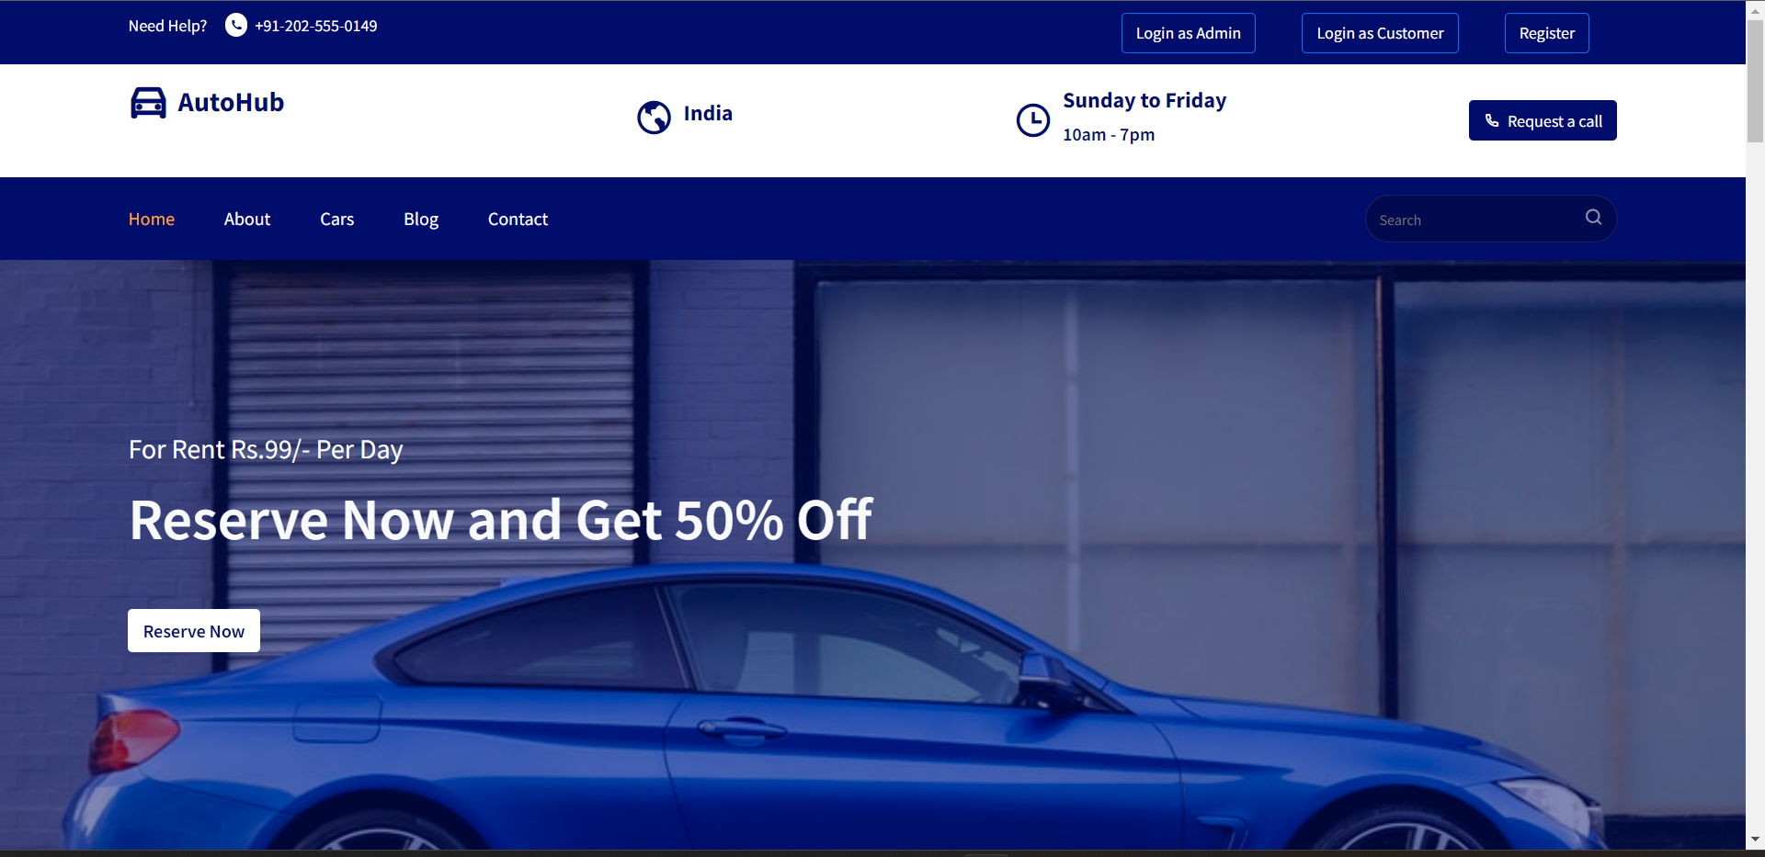
APPLICATION WALKTHROUGH
USERFLOW(HOMEPAGE)

Slide 9
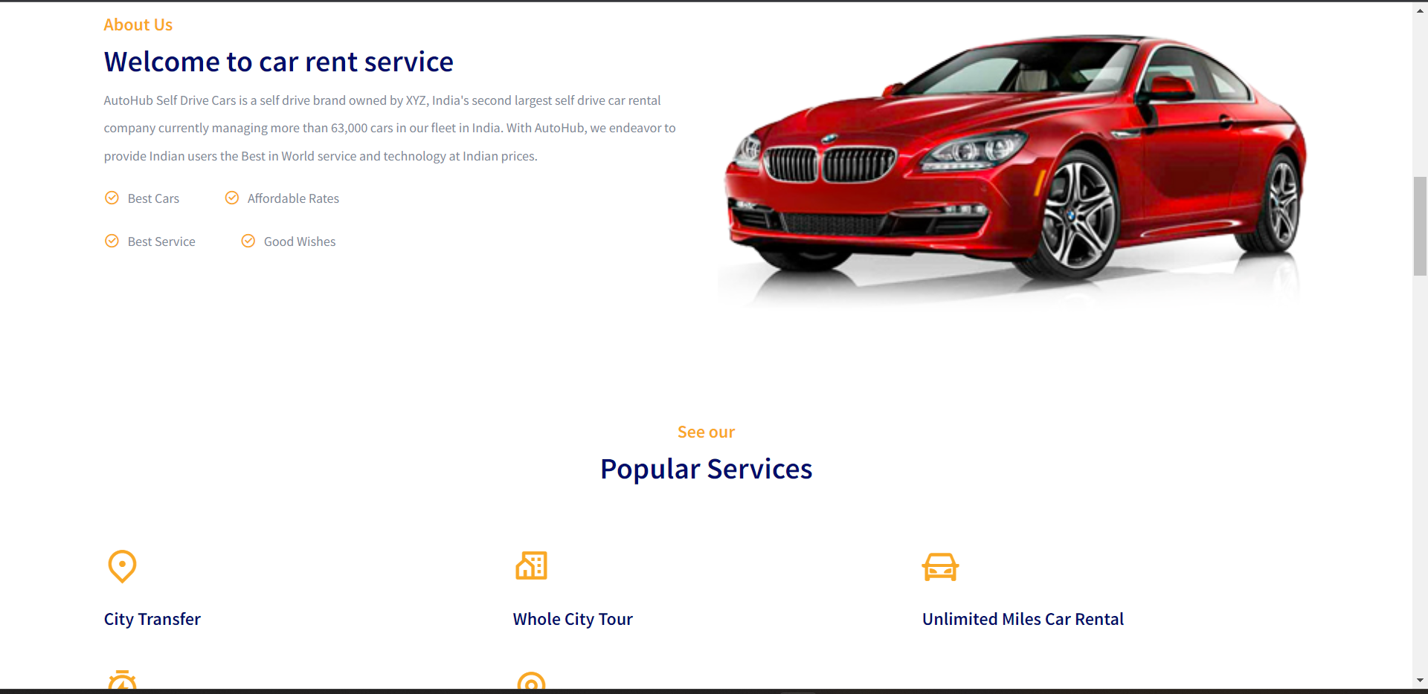

Slide 10
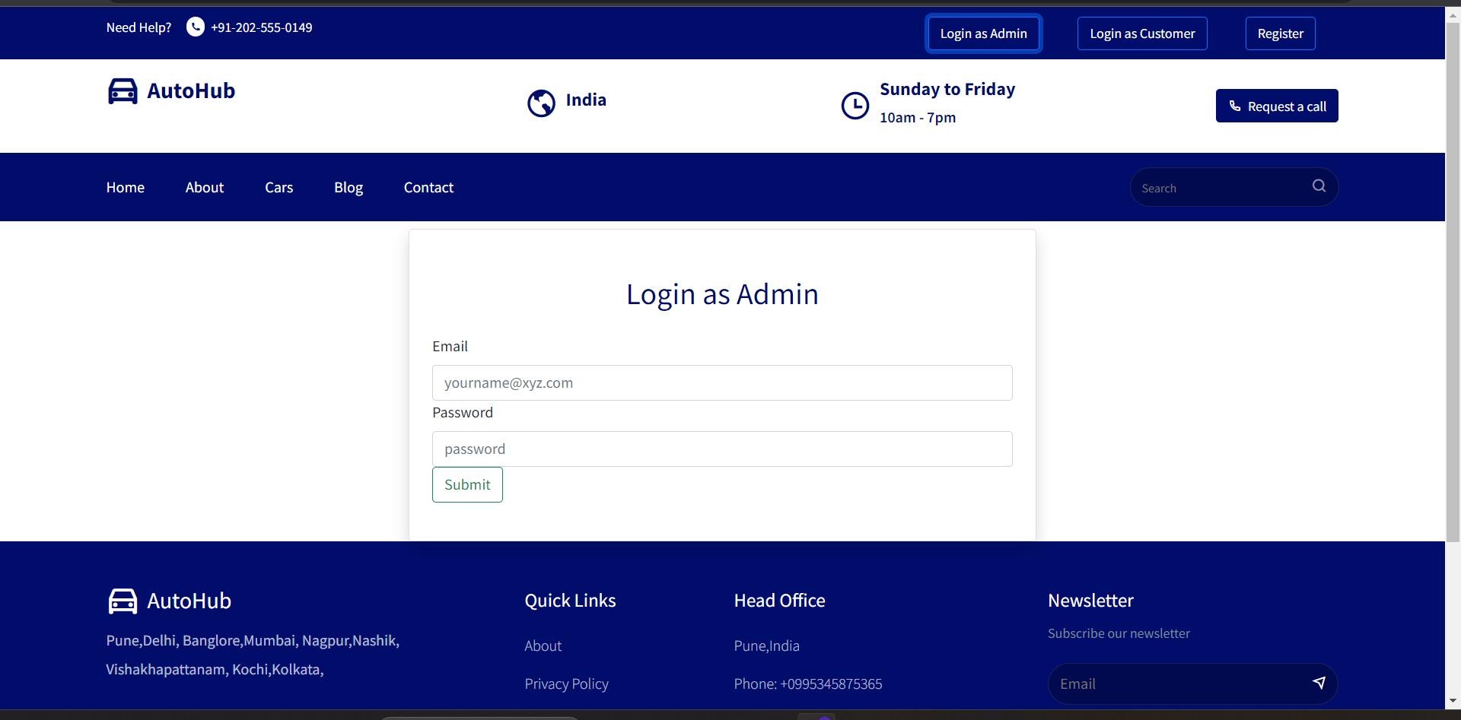
SIGNUP PAGE

Slide 11
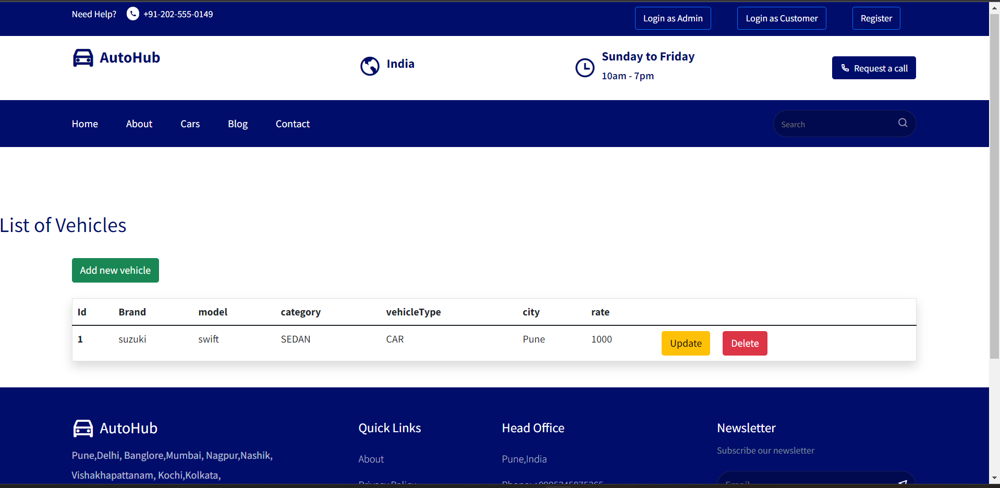
Vehicles available

Slide 12
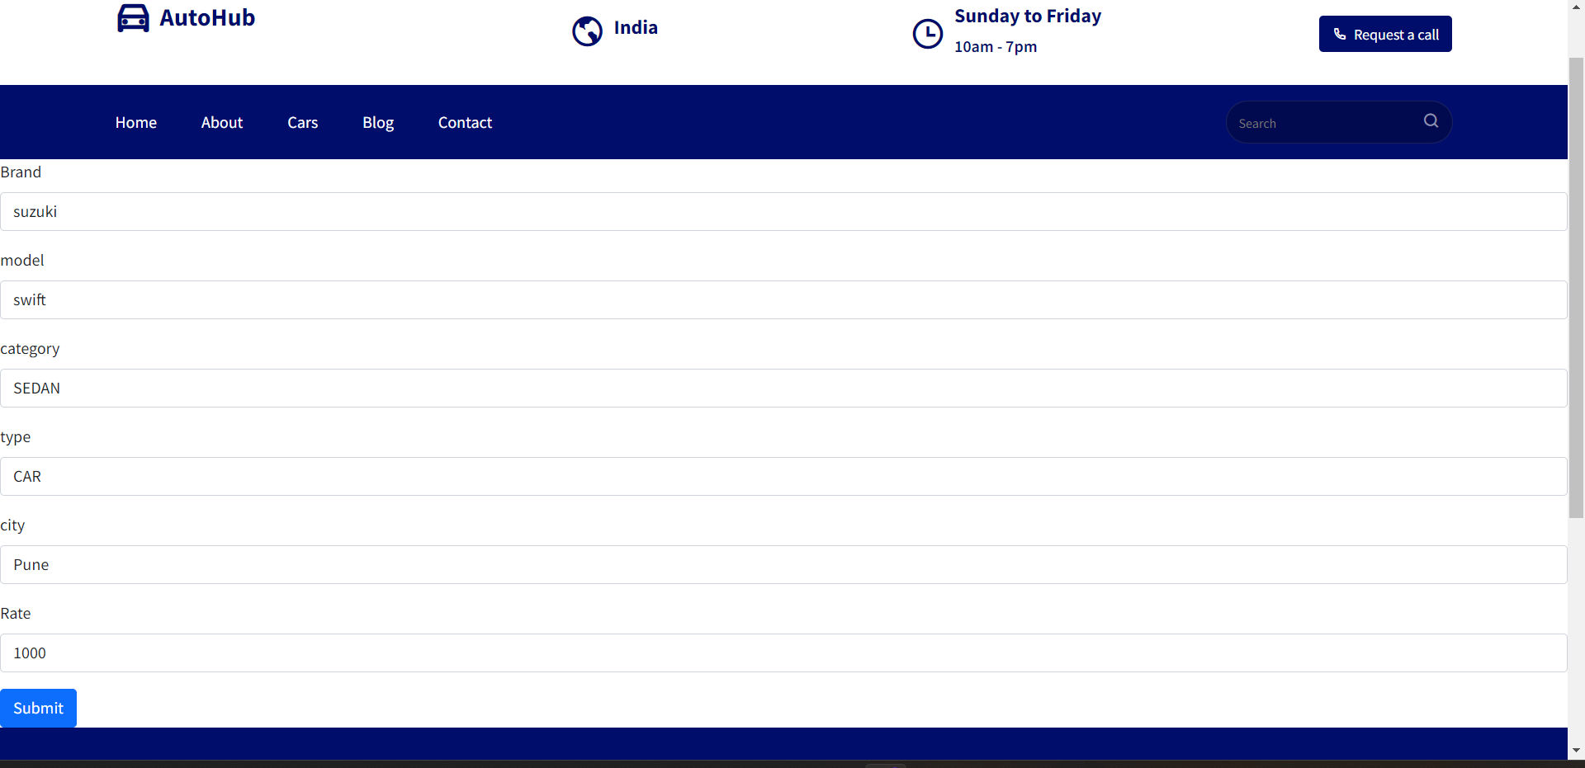
Update Page

Slide 13
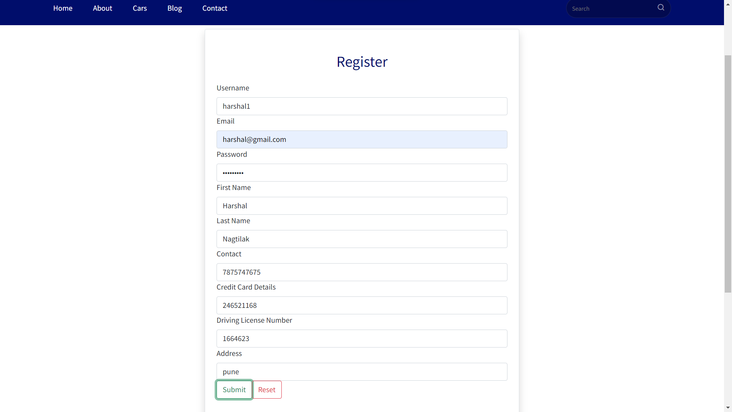
Customer Registration Page:

Slide 14
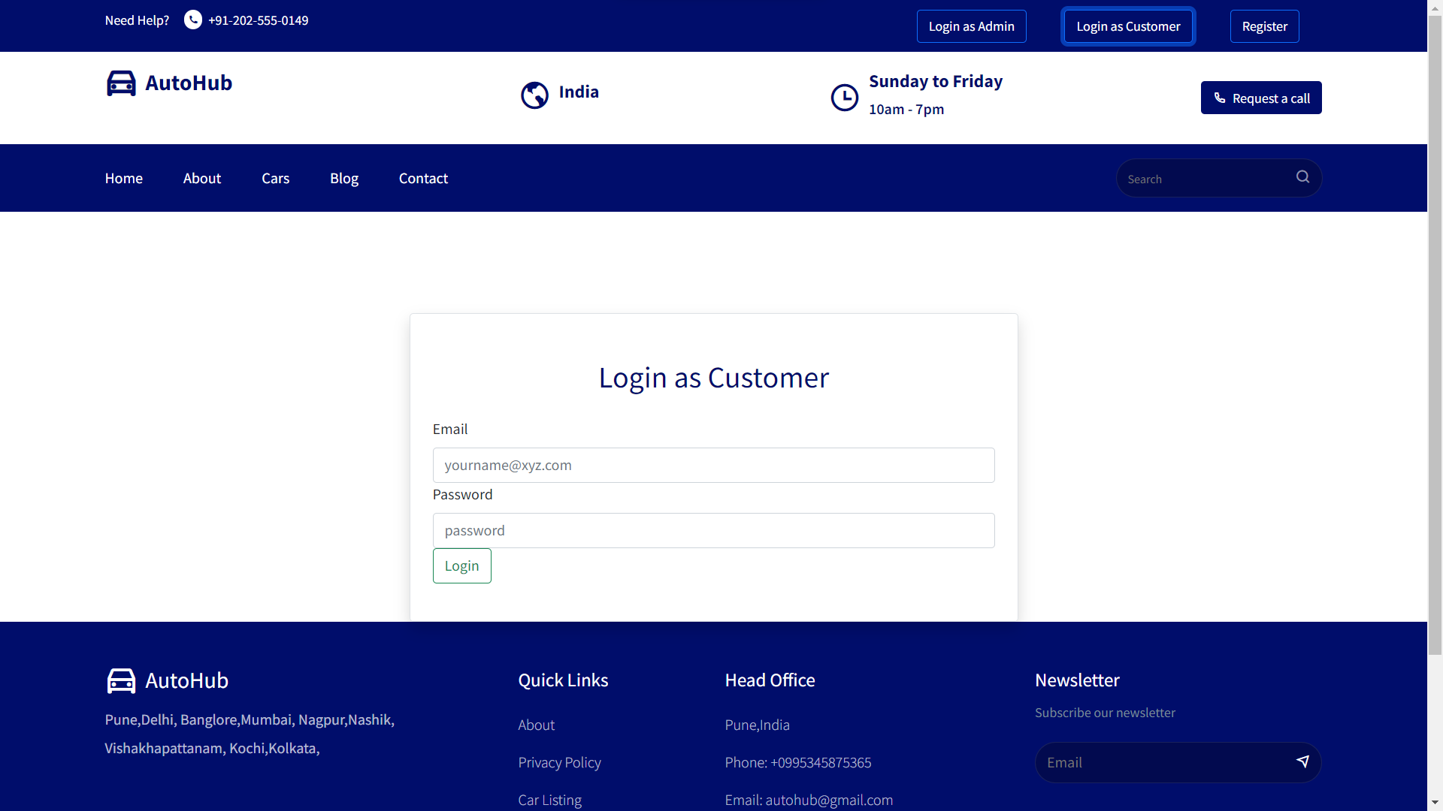
Customer Login

Slide 15
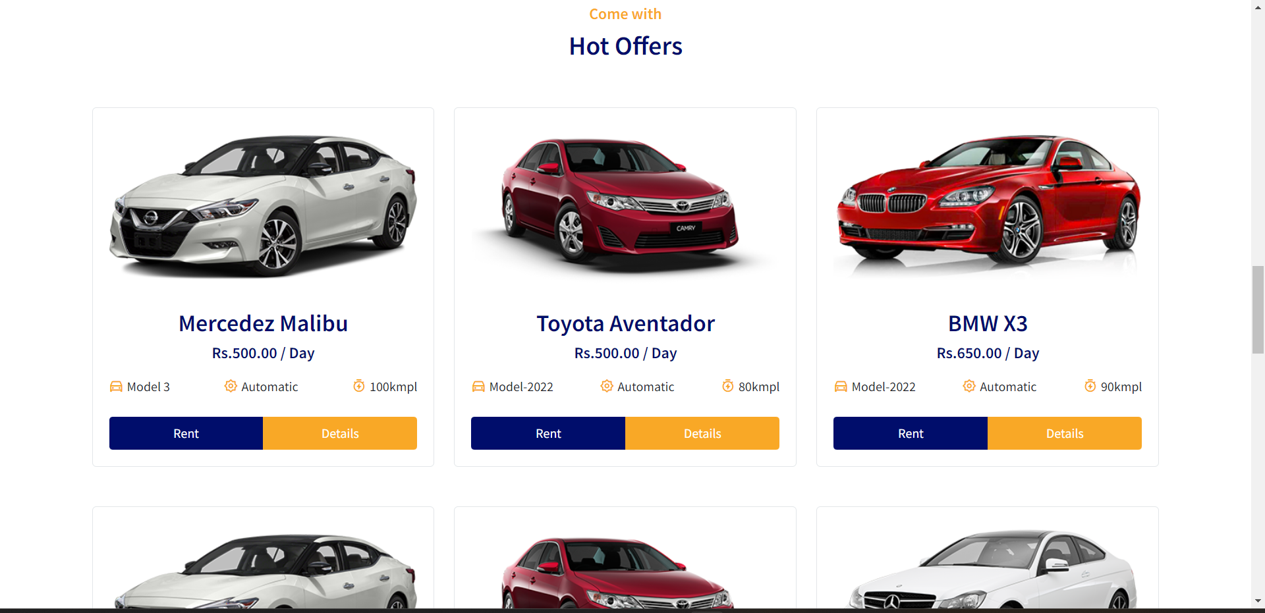
Car Listing

Slide 16
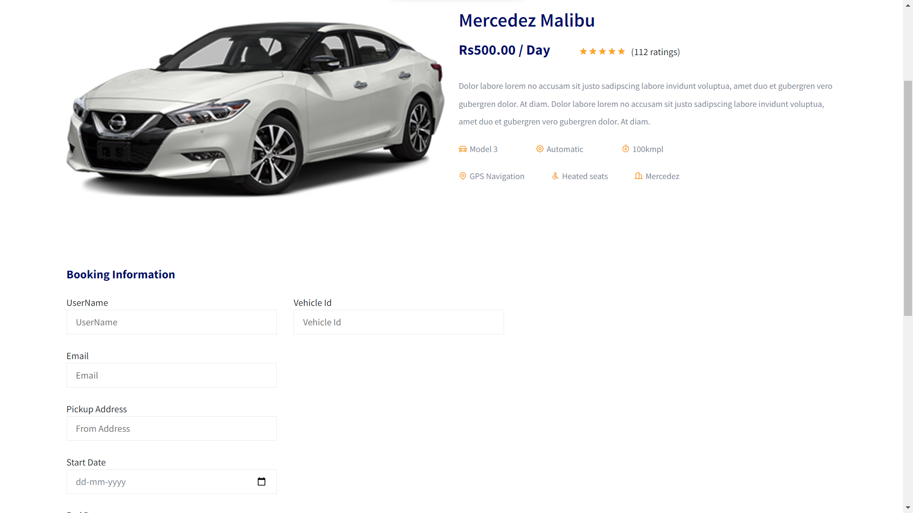
Car Information

Slide 17
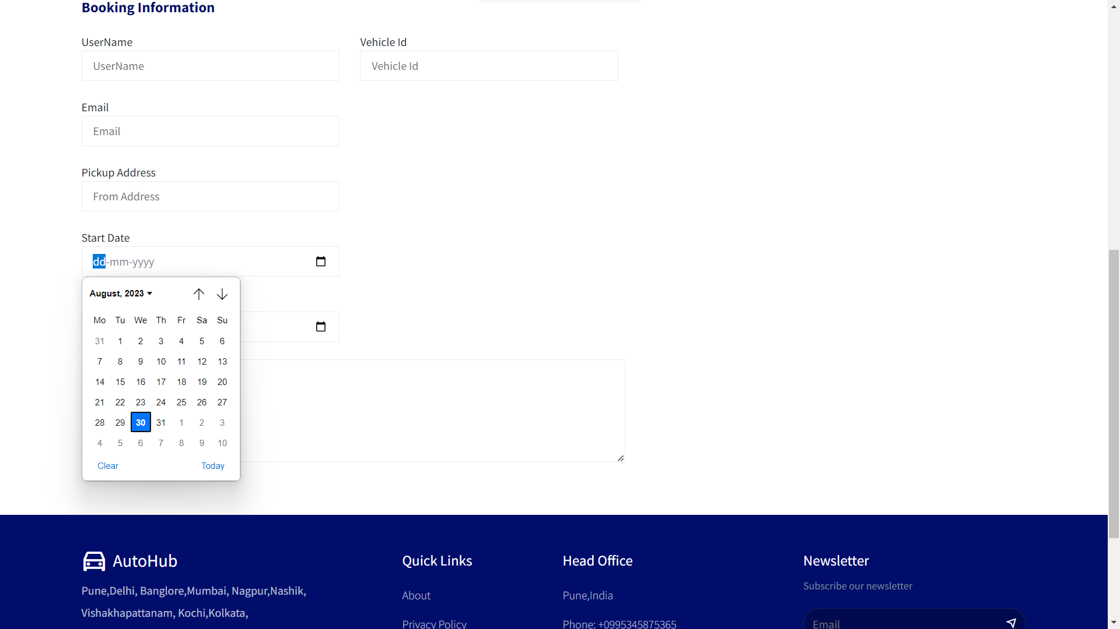
Booking Information

Slide 18
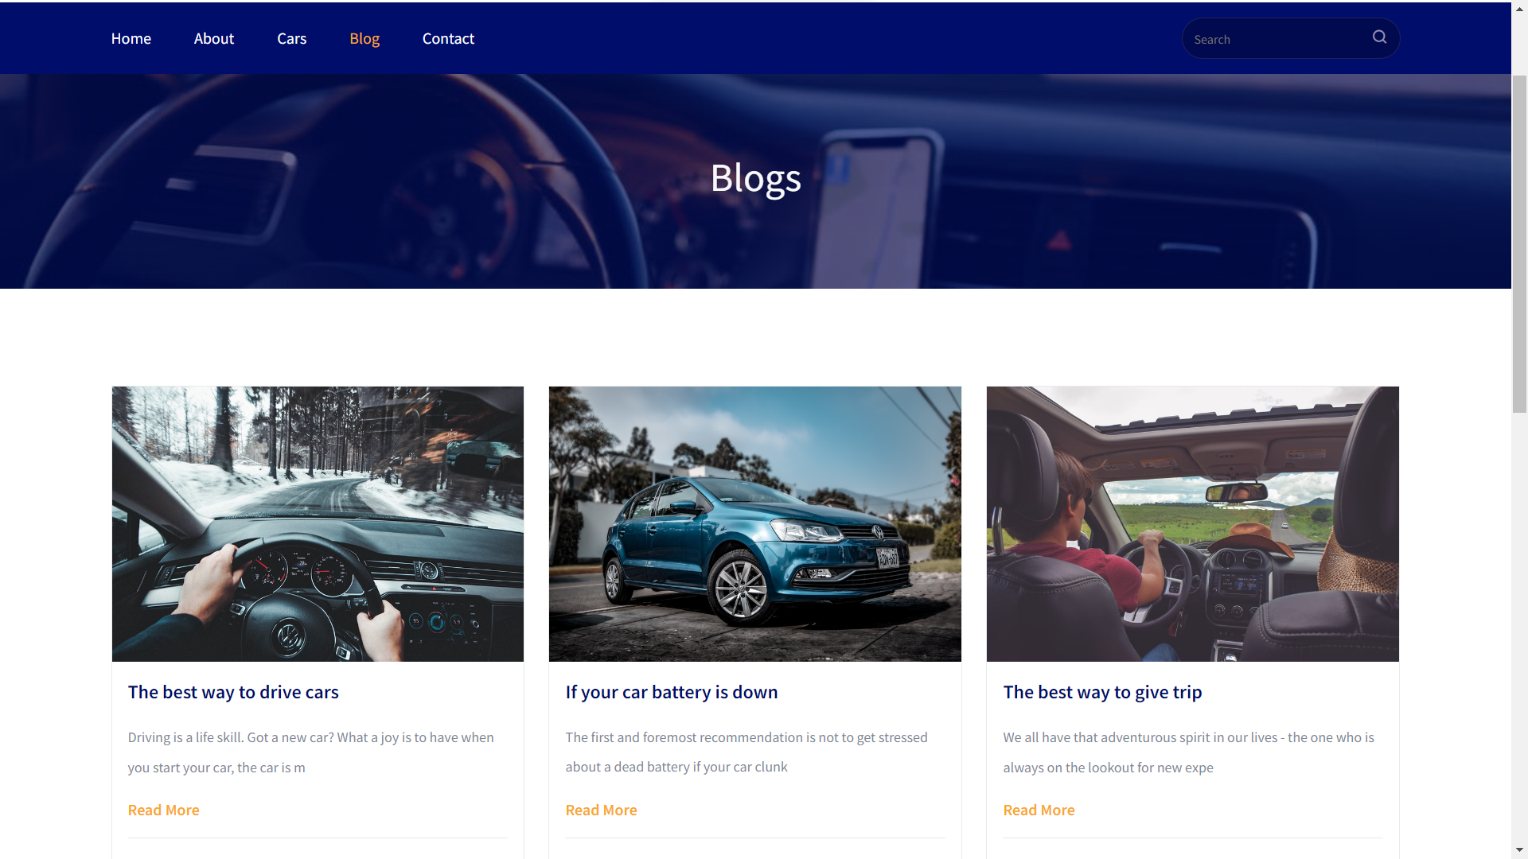

Slide 19
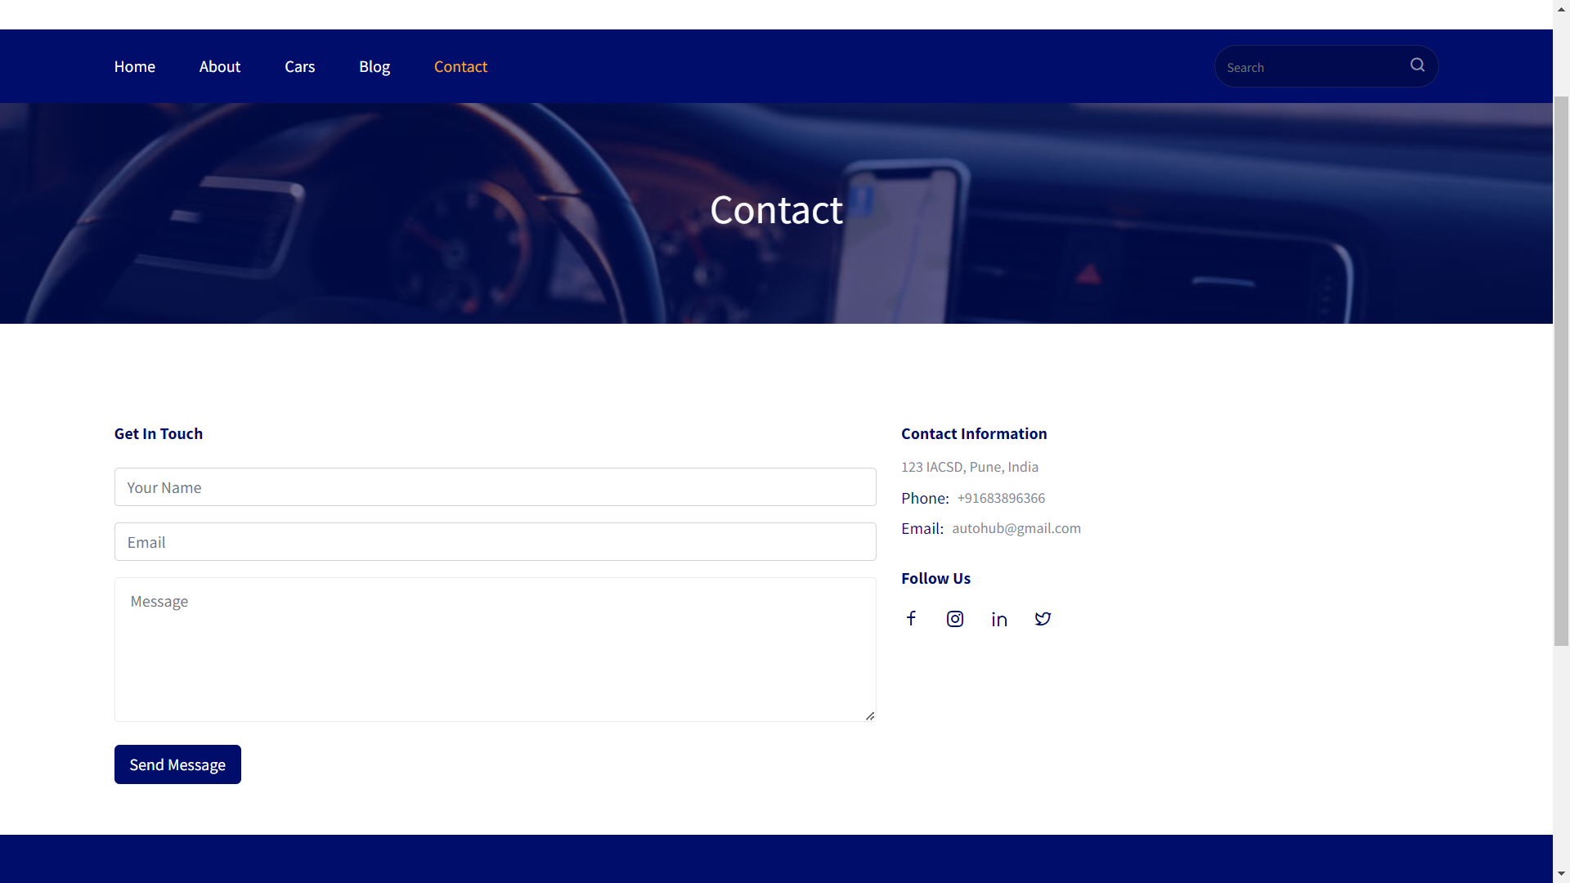

Slide 20
CONCLUSION
In conclusion, developing a robust and user-friendly automotive management system using the power of Spring Boot APIs on the backend and ReactJS, HTML, and CSS on the frontend, we've successfully created an integrated platform that addresses the complex needs of the automotive industry and the customers who are busy with their day to day life.
Throughout this project, we've highlighted the importance of utilizing modern technologies to create seamless communication between the frontend and backend. The Spring Boot framework provided a strong foundation for building APIs that handle data flow, authentication, and business logic efficiently. This ensured that our application is not only performant but also secure.

